Slide 1
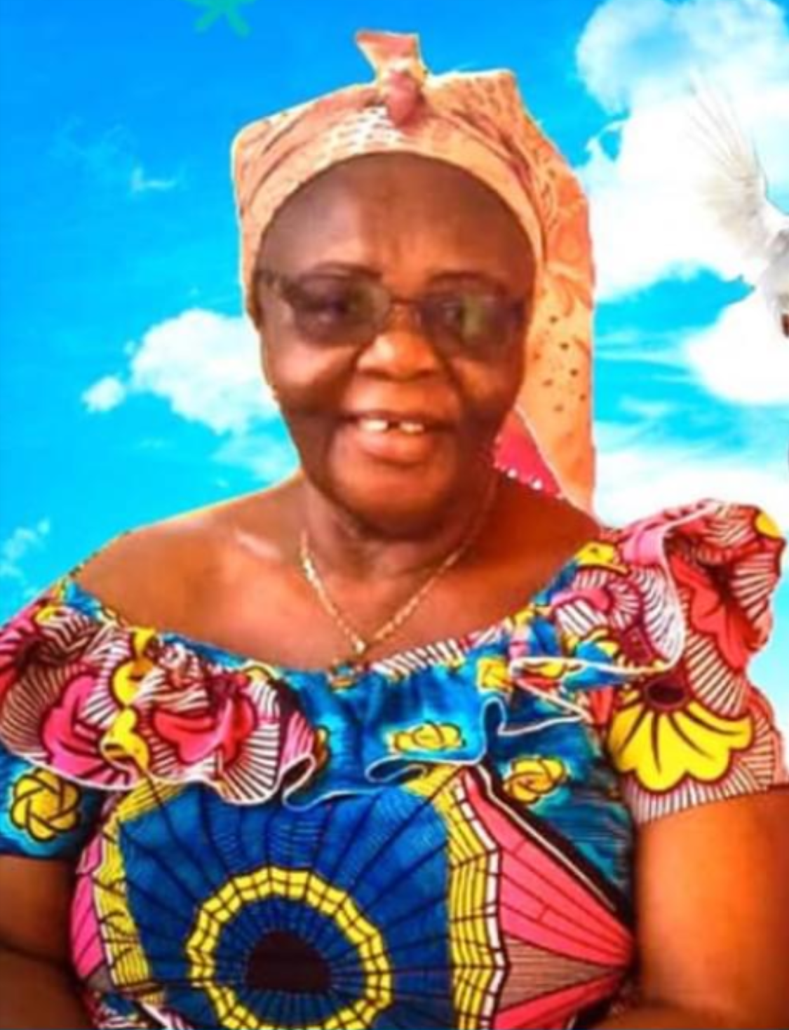
In Loving Memory
Mrs.
Mabel Osei Asibey
(Alias Auntie Serwaa)
5TH September 1947 – 4th May 2020
AGE: 72

Slide 2
ORDER OF SERVICES
BURIAL SERVICE – SATURDAY 6TH JUNE 2020 (12pm – 1.30pm)
VENUE: TRANSITIONS PLACE, HAATSO. BY ST. PETER ANGLICAN CHURCH, MADINA.
OFFICIATING CLERGY:
VENERABLE MAJOR EBEN NII ADDY LARYEA (RTD) – VICAR
REV’D FR FREDRICK OSEI-TUTU - CURATE
Part One: Burial Service
Processional Hymn A&M 400
Intention & Opening Prayers
Hymn MHB 50
Biography & Tributes
Hymn A&M 538
Scripture Reading - 1 Corinthians 15 : 35 – 44
Hymn A&M 280
Sermon
Offertory Hymns - A&M 290, 233
Dedication of Offertory
Part Two: Memorial Service
Hymn A&M Suppl 40
Prayers of Thanksgiving
Hymn A&M 776
Absolution of the Dead
Dead March in Saul
Notices
Recessional Hymn A&M 222
Part Three: Proceedings At The Madina Cemetery
Hymn A&M 401
Lowering of Coffin
Exhortation
Committal
Laying of Wreaths
Hymn A&M 27
Vote of Thanks
Benediction

