Slide 1
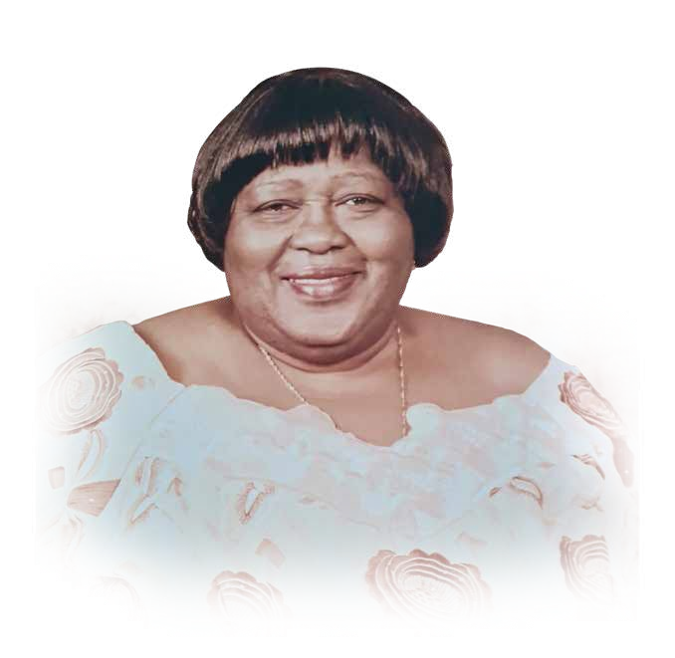

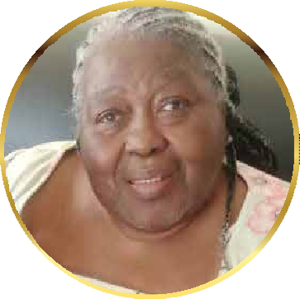

REBECCA OBOSHIE
WENTUM

Slide 2





PROGRAMME
OFFICIATING MINISTERS
Rt. Rev. Christopher Nyarko Andam –
Superintendent Minister (Dansoman Circuit)
Rev. Benjamin E.K Clottey – Circuit Minister (Ebenezer Society)
And others
IN ATTENDANCE
Ebenezer Church Choir
AT THE ORGAN
Emmanuel Kwesi Menson Addo Ebenezer Lamptey
SOCIETY STEWARDS
Bro. David Aryee Sis. Roberta Nettey
PRE-BURIAL SERVICE (PART 1)
Organ prelude
Greetings and Purpose of gathering.
Hymn MHB 110
Prayer.
Filing past of the body: Hymns
Selection - MHB 478; MHB 110; MHB 99;
MHB 511; MHB 491; MHB 492; MHB 371;
MHB 371; MHB 213; MHB 612.
6. Closure of the casket.
BURIAL SERVICE (PART 2)
Processional Hymn - Choir
Scriptural sentences.
Announcement of purpose.
Hymn: MHB 468.
Prayer
Biography and tributes.
Scripture readings:
1st Reading (Psalm 90)
2nd Reading (1Corinthians 5:50-58)
Hymn: MHB 831
Sermon.
Afirmation of faith – Apostles Creed.
Offertory: Song by Singing Band (& Choir).
BURIAL SERVICE
1

Slide 3





THANKSGIVING SERVICE (PART 3)
Hymn: MHB 615
Prayers and commendation.
Announcement and courtesies.
Hymn: MHB 608.
Benediction.
Recessional Hymn - Choir
AT THE GRAVE – INTERMENT (PART 4)
1 Hymn – MHB 976
Prayers and commitment.
Vote of thanks – Family member.
Hymn: MHB 948.
Prayer and Benediction.
BURIAL SERVICE
2

Slide 4
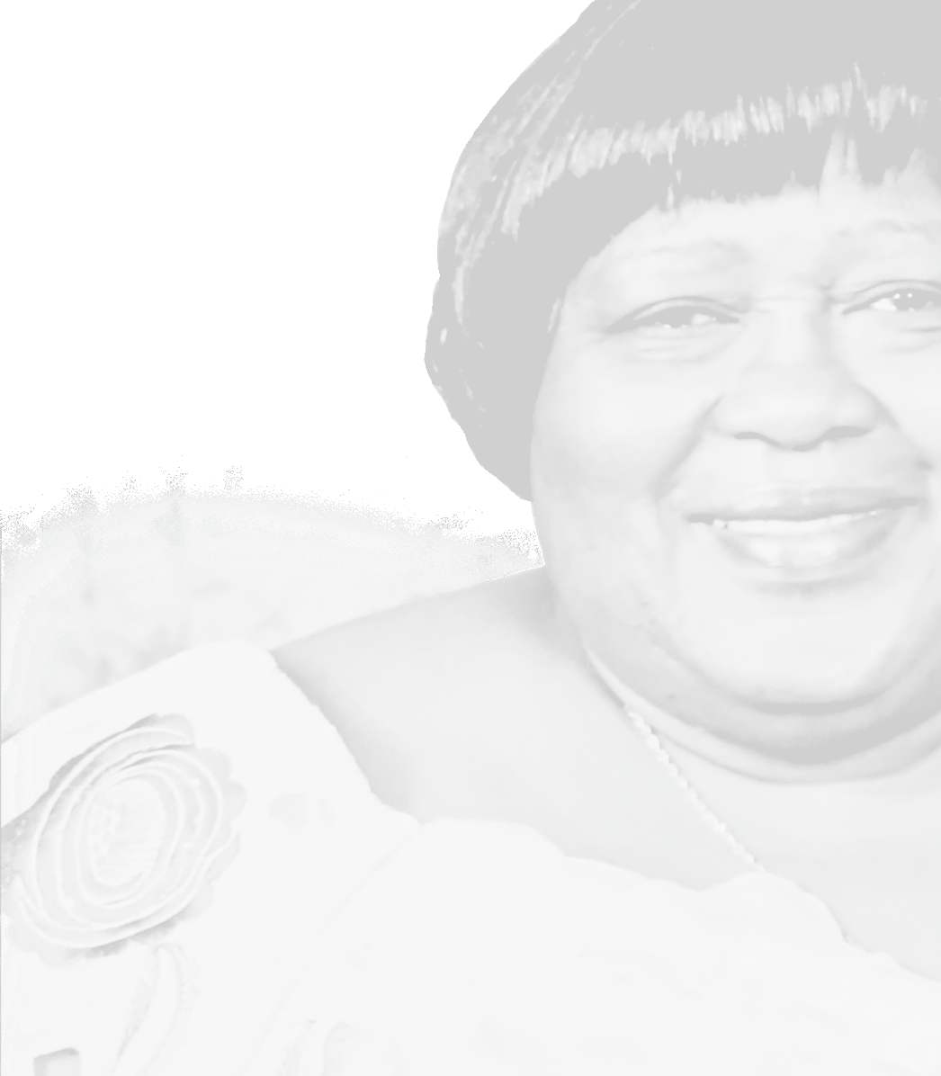






B
I
Of
O
G
R E B E C C A
R
OBOSHIE
A
WENTUM
P H Y
BURIAL SERVICE
3

Slide 5


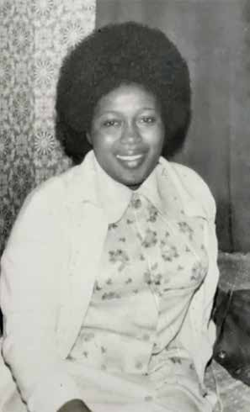




BIOGRAPHY
Rebecca Oboshie Boyle (Nee Wentum) was born on 2nd October, 1941. She was the first born of her
father, Mr. Tetteh Okor / Oboshie Nuke We of Osu Anorhor and the second born of Madam Akweley Ako of Nii Nai Kwami Otun We, La Abese.
She grew up in the care of her paternal grand mother, Naanyo, whom she stayed with until she completed middle school. Becky continued her education at the Presbyterian Secondary School (Sendo). Around this time, her senior sister got married to a priest of the Presbyterian Church at Osu and Becky moved in with her senior sister to help her sister in keeping her home.
Becky continued her education at Accra Girls Secondary School in 1960 when the school commenced. She was one of the pioneers of that new school. She obtained the O’ Level Certificate with credits. Outside of school work and activities she enjoyed dancing. During those years when student union dances were in vogue, Becky always
4
BURIAL SERVICE

Slide 6

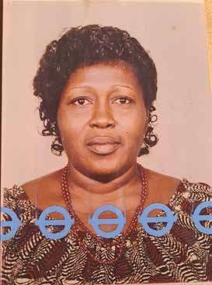




went to those dances with one of her cousins (who unfortunately is already deceased) and they had a great time.
On graduating from the Secondary School, she travelled abroad to continue her education. She was trained in Great Britain as a nurse and midwife. She graduated as a midwife and worked with Royal London Hospital. From Royal London Hospital, she went to work with Palm Court Home for the Elderly.
After she had worked in Britain for some years, she came back to Ghana where she got married to Mr. S.O Boyle in 1978. Becky was born a Presbyterian but by virtue of marriage, she became a Methodist. She started worshipping with the Methodist Church (Ebenezer Society) in Dansoman till she travelled back to London.
While in Britain, she joined the Trinity Methodist Church located at Junction of London and Argyle Road. She worshipped with the society from 1999 to 2016. She could not attend church anymore due to her health condition and difficulties in walking. She was a dedicated Christian who loved to do the work of God.
Becky left behind two children – Jonathan and Joseph – and four grandchildren – Lois, Louisa, Rhoda, and Michelle.
Becky would be remembered as a great wife, mother, grandmother, a good friend, a first class midwife, a devoted Christian and an excellent communicator.
5
BURIAL SERVICE

Slide 7





She would be forever missed for her sense of humor, generosity and benevolence and her attention to details.
Becky, we shall forever miss you.
Fare thee well. Yaaw) ojogban.
6
BURIAL SERVICE

Slide 8


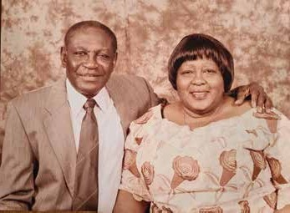



TRIBUTE
BY HUSBAND SAMUEL ODARTEY BOYLE
The righteous perish, and no one takes it to heart; the devout are taken away, and no one understands that the righteous are taken away to be spared from evil.
Those who walk uprightly enter into peace; they find rest as they lie in death. (Isaiah 57:1-2)
A wife is a valuable gift from God to man to make his life complete. Before Rebecca (or Becky as I used to call her) came into my life, I was lonely; my life seemed
incomplete. However, I began to make sense of my life when she became my wife.
Becky was not only my wife, but also my friend. The basis of our long marriage life was our love for each other and mutual understanding. This helped to
maintain a peaceful atmosphere in our home. While I was a cool and calm
person, Becky was warm and lively. She had a sense of humor and a word of comfort to cheer up people who were sad. She was a very courageous person and able to
withstand any adverse circumstance~s~ that life threw at her. . As a nurse who has worked for many years, she was very caring, gentle, and kind to the less fortunate. As a wife, Becky was caring, warm-hearted and co-operative. As a Christian, Becky was slow to anger and quick to forgive. She welcomed all people who came her way and
7
BURIAL SERVICE

Slide 9


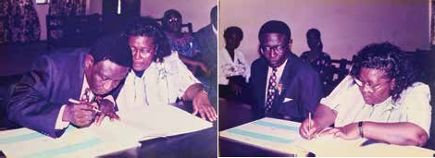

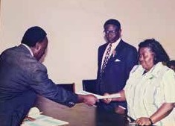
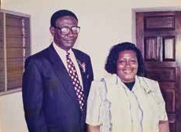


was ready to serve them. Her departure has created a vacuum which can never be filled.
As a devoted Christian, she never missed morning devotion before breakfast. She took delight in singing especially hymns from the Methodist Hymn Book. She also took delight in reading the Bible. She often said, “Know your God and your God will know you.” She never hesitated to go to the kitchen to prepare a meal for the family although she had come home from work very tired. It was her hobby to bake cakes, rock-buns, spin rolls, dough-nuts and prepare marmalade for bread.
Becky, I cannot really measure the pain I feel in your absence right now; but life is a gift from God and cannot complain if God wants you back. It is my prayer that you rest in the bosom of our Lord.
Rest in peace till we meet again.
8
BURIAL SERVICE

Slide 10





TRIBUTE
BY CHILDREN
Jesus said, “I am the resurrection and the life. He who believes in me though he dies, yet shall live again. And who ever believes in me shall never die.” (John 11:25-26)
Maa, we know that death is inevitable, but we never imagined it would come so soon to rob us of your presence. We miss you dearly, but we are comforted by what Paul said,” For me to live is Christ and to die is gain.”
At this sorrowful moment as we bid farewell to you, we thank the almighty God for giving us the opportunity to encounter such a wonderful mother. We will forever
treasure the moments we shared with you.
You were stalwart, affable and virtuous. You were a woman with a great sense of humor. We never felt sad in your presence. You always said,” Know your God and your God will know you. We brought nothing to the world; we would not take anything along. What do you have that was not given to you? And if it was given to you, why then do you boast.” You also said,” do not put your trust in man; man will fail you.” All these words keep ringing in our ears. We shall never forget your small chops - the sweet after meal; dough-nuts, spin rolls, cake and marmalade.You never allowed anyone to
intimidate us. You protected us in every aspect of life just as the hen protects its chicks from the hawk. Our love for you would never fade.
Maa, we love you but the Lord God Almighty loves you more. We desired to have you all the time but the Lord God Almighty much more that you be with Him in eternity. He chose to call you to rest in His bossom on that Wednesday morning. You looked fine when we visited you that morning. You could not talk but tried to show us
9
BURIAL SERVICE

Slide 11
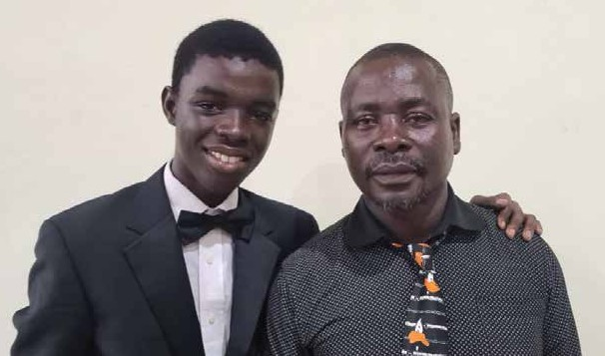

how much you love us. At exactly 10:38am you stopped breathing. The doctors tried to revive you but every effort they made was futile.
Maa, you loved the Lord and so we have assurance that you are in the bossom of the Lord.
Rest, rest in perfect peace till we meet again.
Fare thee well, Maa.
Yaaw) ojogban.
BURIAL SERVICE
10

Slide 12





TRIBUTE
BY GRANDCHILDREN
(LOIS, LOUISA, RHODA AND MICHELLE)
“For if we live, we live to the Lord; and if we die, we die to the Lord. Therefore, whether we live or die, we are the Lord’s.’ (Romans 14:8)
It was really difficult and a sad moment when we had to write a tribute in honor of our beloved grandmother, whom we called Grandma, but we are consoled by the words of the scripture above, knowing that even in death, you are with the Lord. Grandma, your sudden departure into eternity has shocked and brought us deep sorrow, sadness and created a vacuum. We have lost a person who was always there to love us with much action and affection. You were so much interested in our academic work.
You kept on advising us to work hard and also reminded us not to be absent from the kitchen. Anytime I was ready for school, Grandma would smile lovingly and say "Go and take my bag, go and take my bag" beaming with laughter I would rush to the room knowing that money was going to flow. She would always make sure I had enough for school.
We didn’t spend enough time with you because throughout your life, you stayed in Great Britain to give health care to the sick and the aged. But we cherished the few
moments you stayed with us, especially your sense of humor. There was no single moment we came to you without leaving with laughter and funny talks. You were such a great grandma, an epitome of unconditional love. We shall forever remember your small chops; cake, dough-nuts, fruit juice and marmalade with bread.
It really hurts to have lost you at this undue time. You left home that Saturday evening not too weak thinking you would see the doctor and come back home. Little did we
BURIAL SERVICE
11

Slide 13

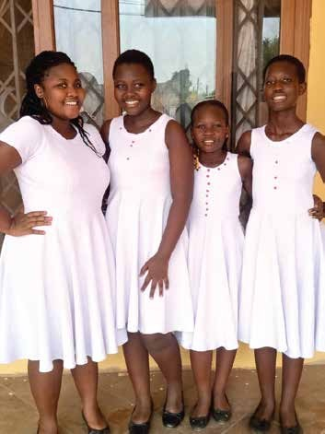




know that death would lay its icy hand on you. We accept that God has decided to take you home and so you are with Him. Please pass our prayer requests to our heavenly
Father for us. Tell him to console us because our hearts are sinking. Your departure is painful and we shall forever remember you. Grandma, rest in perfect peace in the
bosom of the Lord till we meet again.
Grandma, Yaaw) ojogban.
BURIAL SERVICE
12

Slide 14





TRIBUTE
FROM SIBLINGS
(KWAME, OBODAI, AUNTIE J, AJA, COMFORT AND CHRISTIAN)
What shall we say to these things? If God be for us, who can be against us?
To our dear lovely, sweet, and wonderful sister, Rebecca Oboshie Nuke Boyle (Nee Wentum) aka Sister O.B. As we bid you farewell to your glorious life in eternity, we reflect and share this tribute in loving memory of your journey here on earth.
You are the first born and the strength of our father, Mr. C. C. Wentum, of blessed memory; so in many ways we looked up to you for direction which you gladly offered any time we called on you. You were honest, direct, firm and fair in dealing with issues that cropped up in the family. You did not mince words in expressing your sentiments on any subject. Your open and tangible straightforward conversations proved your warm and affectionate love for us - nothing but deep and analytical.
Indeed, we are going to miss your efforts in uniting us as a family (nuclear and extended family). Thank you for being the life wire in our gatherings whenever you visited Ghana as we enjoyed you exuding life and energy in our meetings.
You candidly expressed your opinion on matters related to individuals to our advancement as a family. You did your best in building bridges after times of disagreements.
We will miss you, big sister!
BURIAL SERVICE
13

Slide 15





How come you seem to know everything about family, relations and friends? You truly were interested in every Tom, Dick and Harry. You had your ears on the ground even whiles living in the UK. You were keen on knowing our welfare and willing to go the extra mile to assist and share your material possessions.
Indeed, your love, care and generosity were unconditional.
Sister O.B. thank you for the many stories and family history you shared with us on many occasions, particularly, towards your final days on earth. Assuredly, you left a trail of beautiful memories and indelible marks in the sand of the Wentum Family.
Sister Oboshie, yaa wo jogbann!
Wo ba kpe ekon !
BURIAL SERVICE
14

Slide 16

TRIBUTE
BY MATERNAL NIECE AND NEPHEWS
Today we mourn the passing of our dear aunt, the sister of our late mother. The world knew her as Rebecca Oboshie Wentum (later as Mrs. Rebecca Oboshie Boyle), but to all of us she was “Auntie OB”. Auntie OB has been a part of our lives for as long as we can remember because she lived with our parents from early in their marriage, right from the birth of our eldest twin siblings and continued to be involved with us through many stages of our lives even when she moved to live in the UK. When she moved back briefly to Ghana in the 70’s and 80’s, we recall fond memories of the wonderful times we shared with her before she returned to Britain.
Like Rebecca in the Bible, Auntie OB possessed a charm that drew people to her and made them comfortable in her presence. She enjoyed having people around her and having long conversations with, so we were never short of things to discuss with her. Auntie OB was always a friendly and down-to-earth person, and she was one you could easily get to know because she was an open book and was never pretentious in her dealings. It was easy to know where you stood with Auntie OB. She was quick to come to our defense, but also one who would quickly chastise you when necessary.
One of her favorite sayings that she apparently took from her father was “mɔni kɛ bo baa fee nyɛmi lɛ, kɛ lɛ afee nyɛmi”. This means it is not just those who are born of your parents that should be seen as family. When people relate to you as family, it does not matter that you do not share a blood lineage; they deserve to be equally treated as family. This belief drove
BURIAL SERVICE
15

Slide 17





Auntie OB’s interactions with people, so it is not surprising that she always had a very welcoming disposition towards both those she was connected to by blood and those she encountered along the path of life.
Auntie OB loved life. We remember how much she loved music when she lived with us during our childhoods, and also how she loved to dance. Many of us grew to love some of the same music thanks to her. Like Rebecca in the Bible, she was a hardworking woman who would bend over backwards for her loved ones. She never allowed herself to be overcome unduly by the challenges she encountered in her life and often told us that she refused to be unhappy regardless of the challenges she found herself in. She had a zest for life and was never apologetic about it. This is a side of her that we dearly miss.
Auntie OB, now the day is over. Night has drawn near, and the Keeper of your soul who has been your Shepherd has welcomed you into His Rest. Wɔ ojogbaŋŋ, Auntie OB. With your passing, our dear late grandmother is reunited with all her children. We miss you all and commit you to our heavenly Father’s care. We thank God for your lives. Until the day we meet in glory, and the corruptible becomes incorruptible, we say rest peacefully. Auntie OB, yaa wɔ ei.
Yaa wɔ ooo. Oyiwaladɔŋŋ kɛ ha nɔ fɛɛ nɔ. Amen.
BURIAL SERVICE
16

Slide 18


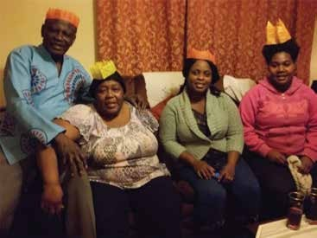



TRIBUTE
FROM EVELYN AYORKOR & FAMILY
Auntie O B, you have been an
inspiring soul, always ready to open your heart to those in need.
I am truly grateful for the way you raised me during my childhood. While you were strict with me, that discipline has had a positive impact on my life today.
Your hospitality was truly marvelous, and you've been the most wonderful and loving mother and grandmother to all of us.
One of the most beautiful aspects of you is our phone conversations. I will deeply miss our long chats.
Auntie, your passing has left a significant void in our hearts. The day you left us was a terrible one, as we lost both a mother and a dear friend.
Rest in peace, Auntie. We often wonder why death took you away so soon, but your memory will forever remain in our hearts.
With heartfelt farewells from Chantel, Naa Lamiley, Salomey, Uncle Percy, and myself.
Until we meet again, yaawo Jogbaann
BURIAL SERVICE
17

Slide 19

TRIBUTE
NEPHEWS & NIECES TO
AUNTIE REBECCA OBOSHIE
Auntie Rebecca Oboshie Wentum - the first sister and beloved Auntie of our Wentum Clan.
How can one encapsulate such a magnificent larger-than-life personality and character in just a handful of words?
Loving?
Generous?
Humorous?
Faithful?
Godly?
Selfless?
Gracious?
Ambitious?
Humble?
Masterful Storyteller?
Advisor?
Nurturer?
Chef?
Hoarder? Curator? [ As you may have seen herself and Uncle Sammy returned to Ghana with a lot of things]
As delightful as these adjectives and nouns are, they scarcely capture the breadth of who you were. Yet, we employ these words to honour the privilege of basking in your
BURIAL SERVICE
18

Slide 20

presence.
As your nephews and nieces, residing alongside you in the UK, we reminisce about our out- ings to treasured restaurants. There was a shared passion for the Chinese buffet at Aroma and the array at Pizza Hut. In our youth, we delighted in indulging ourselves,
playfully competing to see who could eat the most, delighting in the joy and laughter that our childish antics brought you.
Journeys to Southend-on-Sea remain etched in our memories - the seemingly endless car rides or train voyages, brimming with excitement to reunite with our dearest Auntie. You showered us with gifts, regaled us with amusing tales, and, above all, enveloped us in your unwavering love.
While we, your nephews, and nieces in the UK, perceived you as our favoured Auntie, we never sensed favouritism among us. Your reservoir of love, generoisty, kindness, and forgiveness was boundless, and you shared it equitably with us all.
As adults, we continued to visit you and Uncle Sammy. These visits were with or without our parents, offering insight into your journey as a senior nurse, a strong black woman surmounting the odds stacked against you by the NHS and the UK system. Your tales of quirky English colleagues and the patients you cared for sparked our laughter, yet also illuminated your commendable work ethic. Often, over a glass of 'Shloer' (affectionately known as 'Christian Wine'), you would entertain us with these anecdotes, even dispatching us to the local supermarket to secure a bottle for you.
Speaking of stories, some were etched into our minds through repetition. Sai fondly recalls the tale of his 8th birthday when your £50 gift prompted his exclamation, "I'm a Little Rich Boy." Toshie cherishes memories of savoring the tatale you crafted at 19B Gordon Road. And Torgbor cherishes the moments spent with you and Uncle Sammy, resisting slumber to watch TV.
BURIAL SERVICE
19

Slide 21

Your boundless generosity leaves an indelible mark. You were our beacon during Christmases when times were trying for our parents. Your support also spanned birthdays, educational pursuits, relocations, and even the endeavour to secure our first homes. Matthew 6:3 reads, "But when you give to the needy, do not let your left hand know what your right hand is doing."
You epitomised this verse through your altruism. Never did you boast of your selflessness or your servant's heart. The only instances we heard self-revelations of your generosity were when a few, regrettably, took advantage. Even then, you concluded with, "Ahh…Never mind. God knows best," showcasing your forgiveness and unshakable faith. Your generosity sprang from the wellspring of your heart, while your forgiveness stemmed from empathy for human frailty.
We hold dear the memory of you spending time with your 1.5-year-old great niece, Maxima. Even when you learned that Sai had not followed Ga family tradition in naming her after you, you embraced it with grace, jesting, "It's okay; Oboshie is a name for tough girls. Oboshies beat everybody up, and we don't want Maxima to beat everybody up." Watching your health slowly decline after retirement was painful for us to witness, particularly as mobility became more challenging. Yet, even through your discomfort, you managed to infuse joy through your humour and keen memory. Phone conversations would
commence with descriptions of your shoulder pain, yet, by call's end, it would be our cheeks and abdomens aching from the joy and laughter you'd impart.
Phrases such as "It's good to laugh" or "No news is good news" or even the light-hearted "Oh, I'm not talking to you" after a prolonged pause in calls have become cherished
BURIAL SERVICE
20

Slide 22

remnants of your voice. As your nephews and nieces, we'll sorely miss your presence, holding close the memories of your voice.
It'll be an adjustment to see Uncle Sammy without you. The two of you were inseparable, a testament to an unwavering, loving, and Godly marriage. You provided one another space to be, serving as unwavering pillars of support. Uncle Sammy, we extend our heartfelt gratitude for being an exceptional husband to our cherished Aunt. We stand beside you, offering our love and unwavering support.
Auntie Oboshie, we hold you in fond memory. Your legacy encapsulates boldness, courage, and confidence intertwined with kindness, generosity, and humility. We don't say "goodbye" in the traditional sense; but as you and Mama CP would say, "Bye for Now..." So, until we meet again, rest eternally in the arms of our Heavenly Father, dear good and faithful servant. Our love for you is everlasting.
BURIAL SERVICE
21

Slide 23
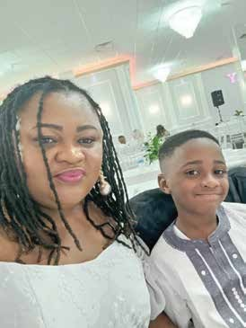

TRIBUTE
BY BEATRICE ANSAH-ATTOH (MAA BEA)
“For My thoughts are not your thoughts, neither are your ways my ways, says the LORD.
For as the heavens are higher than the earth, so are my ways higher than your ways and my thoughts than your thoughts.” Isaiah 55:8-9 (KJV)
Who are we to challenge God for taking what he owns. We will not utter a word against his decision. Tears roll down or heavy cheeks not because we dislike God’s decision but of the fond memories we have had together.
We confidently count ourselves lucky getting close to you. Parting ways with you today is so intense and difficult to bear. Maa Becky, where are you for Shidaa to give you a hard or soft massage with his little fingers. How can we say goodbye when we need you here with us.
Aunty Becky, Shidaa and I will really miss your laughter and guidance. We will hold you in our hearts forever. Rest well in the bosom of the Lord
Till we meet again.
BURIAL SERVICE
22

Slide 24

TRIBUTE
TO THE LATE MADAM REBECCA BOYLE FROM THE EBENEZER METHODIST CHURCH, DANSOMAN CIRCUIT, ACCRA.
“For whether we live, we live onto the Lord, And whether we die, we die onto the Lord:
Whether we live therefore, or die, we are the Lord’s”. (Roman 14:8)
We have come together today to pay Tribute to our dear mother, sister and friend, Mrs. Rebecca Boyle. The sad and unexpected news about her passing on came to us as a big blow.
Mrs. Rebecca Boyle, affectionately called Aunty Becky by most of us, was a professional Nurse, a staunch Methodist and one of the old members of our Society, the Ebenezer Methodist Society. She was the wife of our Senior Brother S.O. Boyle, a seasoned Lay Preacher. She served The Methodist Church Ghana diligently both in Ghana and in the United Kingdom (UK) and supported the ministry of her dear husband, caring for him and accompanying him on his Preaching appointments.
Aunty Becky travelled to UK in the year 1990 where she worked; being a good Christian and a true Methodist, she joined the Trinity Methodist Church in the UK. She was later joined by her dear husband. Both of them became members of the Trinity Methodist Church but they were also members of our Distant Members’ Class under Sis. Gladys Afarchoe Odoi, the Class Leader, and they were paying their tithes. In the spirit of Connexionalism, they played the needed roles in that Church.
BURIAL SERVICE
23

Slide 25

Although they were abroad, they were in touch with us and the progress of our Society has been their concern, especially the state of our new Chapel, where we are now worshipping. They were a beautiful couple, always together and doing things together. Any time they came home, some of our members would visit them to brief them on the developments in our Society, which they cherished so much. They would also attend Church Service to share fellowship and meet old friends.
Information reached us that they have come back home and we were planning to give them a surprise visit; Sis. Afarchoe called to discreetly find out if they would be home; the sad and unexpected news about her passing on on 26th July 2023 was then broken to her by Bro Boyle. It shocked the Church leadership and entire membership because we would have loved to see both of them before her demise. But God knows best and whatever He does is good.
Aunty Becky will be sorely missed for her simplicity, care, love and support to the Church, her family, the nation and mankind.
Aunty Becky, you are home, where there is no more pain, no more sorrow and no more sickness. Rest peacefully with the Lord, who blessed you to us and in His own time has come for you to be with Him forever. May His name be praised!!!
Our sincere condolences go to her dear husband, Bro. S.O. Boyle, the children and the entire family.
Now the Labourer’s task is o’er Now the battle day is past Now upon the farther shore Lands the voyager at last Father in thy gracious keeping,
BURIAL SERVICE
24

Slide 26


Leave we now thy servant sleeping. (MHB.976)
Aunty Becky, rest in perfect peace.
Yaa wↄ ojogbaŋ yɛ wↄ Tsɛ Ofe lɛ kpↄkↄi amli. Amen
BURIAL SERVICE
25

Slide 27







MHB 110 7.7.7.7.B.
1. JESU, Lover of my soul, Let me to Thy bosom fly, While the nearer waters roll,
While the tempest still is high:
Hide me, O my Saviour, hide,
Till the storm of life be past; Safe Into the haven guide, O receive my soul at last.
bring;
Cover my defenceless head With the shadow of Thy wing.
Let the healing streams abound,
Make and keep me pure within:
Thou of life the fountain art,
Freely let me take of Thee, Spring Thou up within my heart,
Rise to all eternity. Amen.
3. Thou, O Christ, art all I want,
More than all in Thee I find. Raise the fallen, cheer the faint,
Heal the sick, and lead the blind :
Just and holy Is Thy name, I am all unrighteousness; False and full of sin I am,
Thou art full of truth and grace.
MHB 478
1. JESUS,my Saviour, Brother, Friend,
On whom I cast my every care,
On whom for all things I depend,
Inspire, and then accept,my
2. Other refuge have I none, Hangs my helpless soul on Thee;
Leave, ah! leave alone,
Still support and me:
me not
comfort
4. Plenteous grace with Thee is found,
is Grace to cover all my sin;
All my trust on Thee stayed,
All my help from Thee I
BURIAL SERVICE
26

Slide 28





prayer.
5. His sacred unction from above
Be still my Comforter and Guide;
1.HOW sweet the name of Jesus sounds
In a believer's ear !
It soothes his
sorrows, heals his wounds, And drives away his fear.
2. If I have tasted of Thy grace,
The grace that sure salvation brings;
If with me now Thy Spirit stays,
And hovering hides me in His wings:
Till all the remove, And In my reside.
hardness He
loving heart
2. It makes the wounded spirit whole,
And calms the troubled breast;
Tis manna to the hungry soul,
And to the weary rest.
6. Jesus, I fain would walk in Thee,
From nature's every path retreat;
Thou art my Way, my Leader be,
And set upon the rock my feet.
3. Still let Blm with my weakness stay,
Nor for a moment's space depart,
Evil and danger turn away, And Keep till He renews my heart.
3. Dear name I the Rock on which I build,
My shield, and hiding-place, My never-failing treasury, filled
With boundless stores of grace!
7. Uphold me, Saviour, or I fall,
O reach me out Thy gracious hand!
Only on Thee for help I call,
4.When to the right or left I stray,
His voice behind me may I hear :
Return, and walk In Christ thy way;
Fly back to Christ, for sin Is near.
Only by stand.
Amen.
faith in Thee I
4. Jesus, my Shepherd,
Brother,
Friend, My Prophet, Priest,
MHB 99
BURIAL SERVICE
27

Slide 29





and King,
My Lord, my Life, my Way, my End,
Accept the praise I bring.
grace!
Saviour Is near,
And for my relief will surely appear :
By prayer let me wrestle, and Ha will perform;
With Christ in the vessel, I smile at the storm, ,
4. Jesus, my Sheherd, Brother,
Friend, My Prophet, Priest, and King,
My Lord, my Life, my Way, my End,
Accept the praise I bring.
5. Weak is the effort of my heart,
And cold my warmest
thought;
2. Though dark be my way, since He is my Guide,
Tls mine to obey, 'tis His to pro¬vide;
Though cisterns be broken and creatures all fall,
The word He hath spoken shall surely prevail.
But when I see Thee as Thou art I'll praise Thee as I ought.
5. Weak is the effort of my heart,
And cold my warmest
6.T ill then I would Thy love proclaim
With every fleeting breath; And may the music of Thy name
Refresh my soul In death. Amen.
And to the weary rest.
thought;
But when I see Thee as Thou art I'll praise Thee as I ought.
3. HIS love in time past forbids me to think
He'll leave me at last In trouble to sink;
While each Ebenezer I have in review
Confirms His good pleasure to help me quite through.
6. Till then I would Thy love proclaim
With every fleeting breath; And may the music of Thy name
Refresh my soul In death. Amen.
3. Dear name I the Rock on which I build,
My shield, and hiding-place, My never-failing treasury, filled
With boundless stores of
MHB 511
1. BEGONE,unbelief; my
BURIAL SERVICE
28

Slide 30

4. Why should I complain of want or Distress,
Mustering array, Wait for hours:
their unseen
thy unguarded
6.Watch, as If on that alone Hung the Issue of the day: Pray, that help may be sent down :
Watch and pray.
Temptation or pain? He told me no less;
The heirs of salvation, I know from His word, Through much tribulation must follow their Lord.
Watch and pray.
3.Gird thy heavenly armour on;
Wear It ever, night and day; Ambushed lies the evil one: Watch and pray.
MHB 468
1.NEARER, my God, to Thee,
Nearer to Thee
E'en though It be a cross That ralseth me,
Still all my song shall be, Nearer, my God, to Thee, Nearer to Thee
5. Since all that I meet shall work for my good,
The bitter is sweet, the medicine food;
Though painful at present, 'twill cease before long; And then, O how pleasant the conqueror's song
4.Hear the victors who o'ercame;
Still they mark each warrior's way;
All with one sweet voice exclaim,
Watch and pray.
2.Though,like the wander- er,
The sun gone down, Darkness be over me, My rest a stone,
Yet in my dreams I'd be Nearer, my God, to Thee, Nearer to Thee
MHB 491
1. CHRISTIAN, seek not yet repose;
Cast thy dreams of ease away;
Thou art in the midst of foes:
Watch and pray.
5.Hear, above all. hear thy Lord,
Him thou lovest to obey; Hide within thy heart His word:
Watch and pray.
3.There let the way appear
2.Principalities and powers,
BURIAL SERVICE
29

Slide 31

Steps unto heaven;
All that Thou send'st to me
In mercy given; Angels to beckon me
faith to rise
Within the veil, and see The saints above, how great their joys,
How bright their glories be.
Possess the promised rest.
5.Our glorious Leader
claims our praise
For His own pattern given; While the long cloud of witnesses
Show the same path to heaven.
Nearer, my God, to Thee, Nearer to Thee
4.Then, with my waking thoughts
Bright with Thy praise, Out of my stony griefs Bethel I'll raise;
So by my woes to be Nearer, my God, to Thee, Nearer to Thee!
2.Once they were mourners here below,
And poured out cries and tears;
They wrestled hard, as we do now,
With sins, and doubts, and fears.
MHB 615
1.GUIDE me, O Thou great Jehovah,
Pilgrim through this barren land;
I am weak, but Thou art mighty;
Hold me with Thy powerful hand :
Bread of heaven! Feed me now and evermore.
3.1 ask them whence their victory came;
They, with united breath, Ascribe their conquest to the Lamb,
Their triumph to His death.
5.Or if on joyful wing Cleaving the sky,
Sun, moon, and stars forgot,
Upwards I fly,
Still all my song shall be, Nearer,my God,to Thee, Nearer to Thee
4.They marked the foot- steps that He trod,
His zeal inspired their breast;
2.Open Thou the crystal fountain,
Whence the healing stream shall flow;
MHB 831
1.GiVE me the wings of
And, following their incarnate God,
BURIAL SERVICE
30

Slide 32





Let the fiery, cloudy pillar Lead me all my journey through :
Strong Deliverer! Be
Thou still my help and shield.
our rule,
Thy word; Our end, the glory of the Lord.
There the tears of earth are dried;
There Its hidden things are clear;
There the work of life is tried
By a juster Judge than here.
There the Shepherd,
2.By Thine unerring Spirit led,
We shall not in the desert stray;
We shall not full direction need,
Nor miss our providential way;
As far from danger as from fear,
While love, almighty love, is near.
3.When I tread the verge of Jordan,
Bid my anxious fears subside;
Death of deaths,and hell's destruction,
Land me safe on Canaan's side :
Songs of praises I
will ever give to Thee.
bringing home
Many a lamb forlorn and strayed,
Shelters each, no more to roam,
Where the wolf can ne'er Invade.
MHB 976
1.NOW the labourer's task is o'er,
Now the battle-day Is past; Now upon the farther shore
There the penitents who turn
To the Cross their dying eyes
All the love of Jesus learn At His feet in paradise.
There no more the powers of hell
MHB 608
1.CAPTAIN
host,and Guide
of Israel's
Of all who seek the land above,
Beneath Thy shadow we abide,
The cloud of Thy protecting love;
Our strength, Thy grace;
Lands the voyager at last. Father, in Thy gracious keeping
Leave we now Thy servant sleeping.
BURIAL SERVICE
31

Slide 33





Can prevail to mar their peace;
Christ the Lord shall guard them well,
He who died for their release.
glories pass away;
Change and decay In all around I see ;
O Thou who changest not, abide with me
3.1 need Thy presence
and point me to the skies; Heaven's morning breaks, and earth's vain shadows flee :
In life. In death, O Lord, abide with me
6.Earth to earth, and dust to dust
Calmly now the words we say;
Left behind, we wait in trust
For the resurrection day.
every passing hour;
What but Thy grace can foil the tempter's power?
Who like Thyself my guide and stay can be?
Through cloud and sunshine, O abide with me.
MHB 948
1.ABIDE with me;fast falls the eventide;
4.1 fear no foe, with Thee at hand to bless;
Ills have no weight, and tears no bitterness;
Where is death's sting? where, grave, thy victory?
I triumph still. If Thou abide with me.
The darkness deepens; Lord, with me abide!
When other helpers fail, and comforts flee,
Help of the helpless, O abide with me.
5.Hold Thou Thy Cross before my closing eyes; Shine through the gloom,
2.Swift to Its close ebbs out life's little day;
Earth's joys grow dim, its
BURIAL SERVICE
32

Slide 34


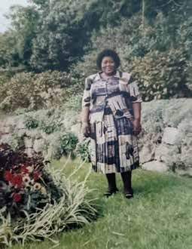

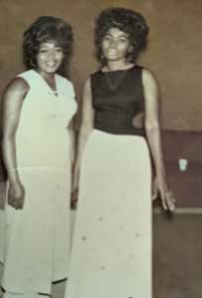
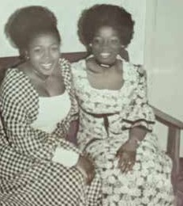
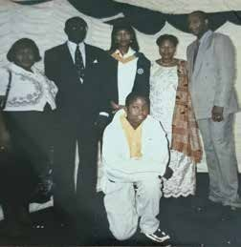
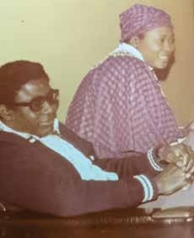
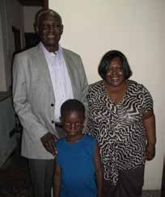


MEMORIES SHARED

Slide 35
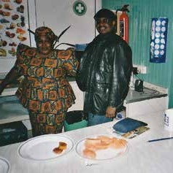
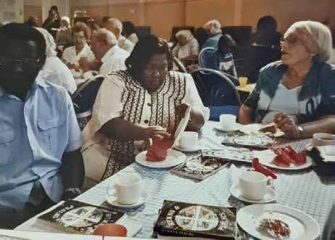
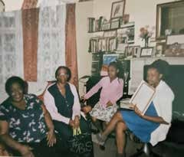
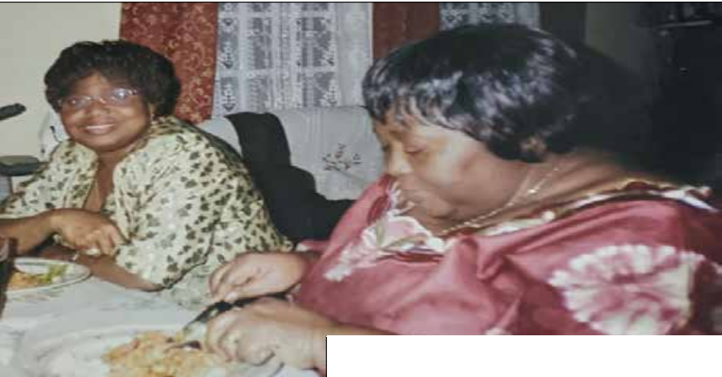
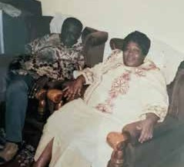


Slide 36

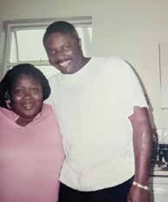
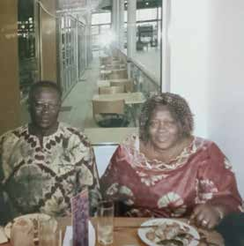
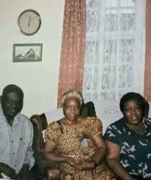

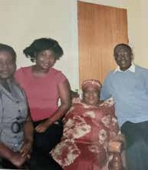
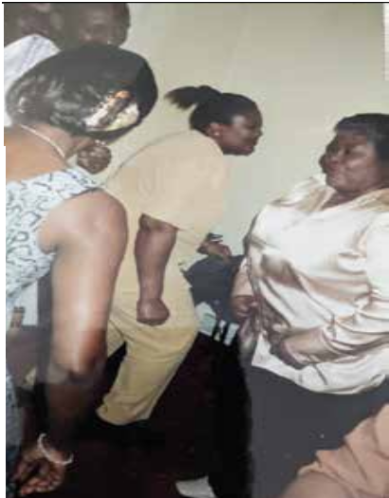
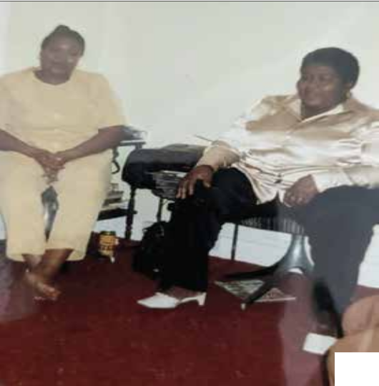

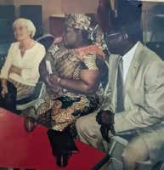



Slide 37

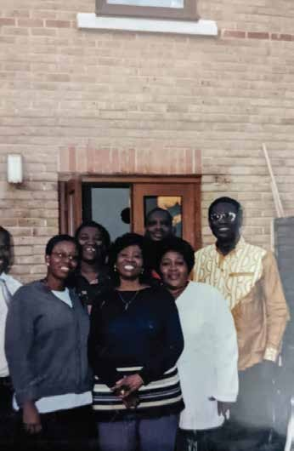
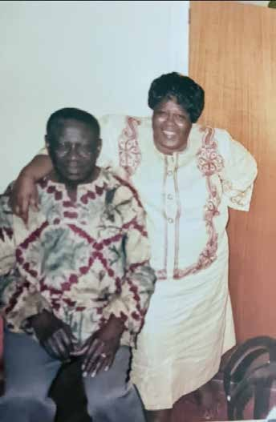





Slide 38

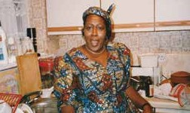
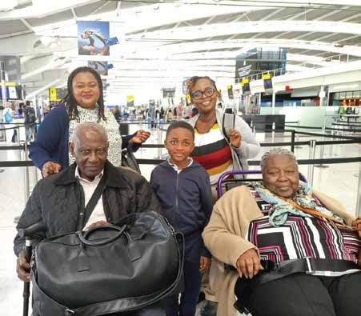

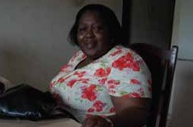

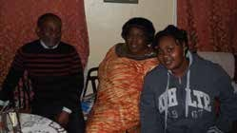
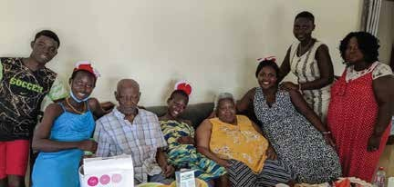
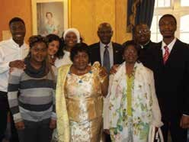



Slide 39

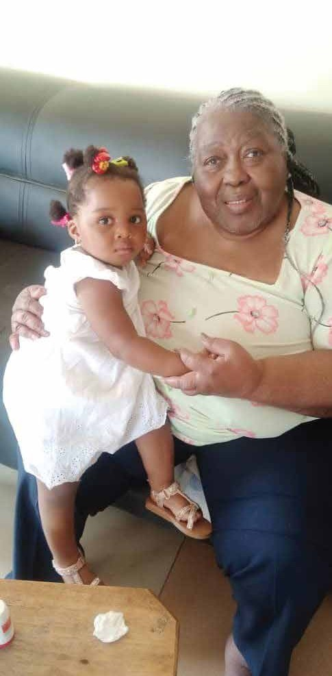
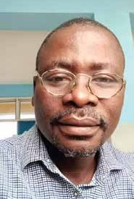
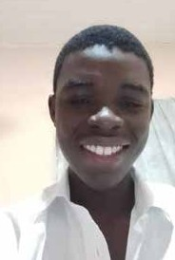

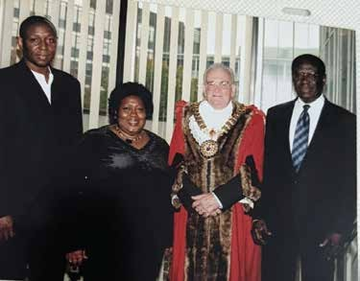




Slide 40

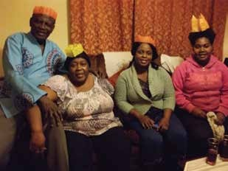
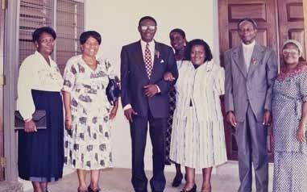

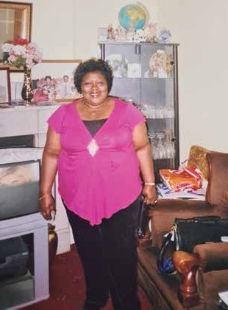
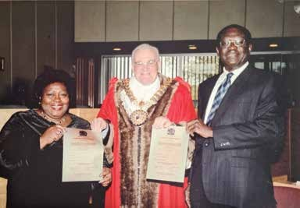




Slide 41
NOTES

Slide 42














REBECCA OBOSHIE
WENTUM
The entire family of
Wishes to express their sincere appreciation for your prayers, presence, sympathy and expression of love in diverse ways and your generous donations during our time of grief.
May The Good Lord Bless You Abanduntly !!!
Designed and Printed by
EXPRESSIONS
0248 084 426

